Slide 1

Data 603 – Big Data Platforms
Lecture 10
Apache Spark MLlib - Part 2

Slide 2
Hyperparameter Tuning
Hyper parameters vs Parameters
A hyperparameter is an attribute defined about the model prior to training.
It is not learned during the training process. Parameters are learned during the training process.

Slide 3
Tree-Based Models
Tree-based models
Decision trees
Gradient boosted trees
Random forests

Slide 4
Decision Trees
Decision Trees are …
Sequence of if-then-else rules learned from the data
Can be used for classification or regression
Relatively fast to build
Highly interpretable
Scale-invariant – standardizing or scaling the numeric features do not change the performance of the tree.
Series of if-then-else rules learning from the data for classification or regression tasks.
Not always the most accurate model
Sensitive to the specific data they were trained on

Slide 5
Decision Trees
The depth of a decision tree is the longest path from the root node to any given leaf node.
Trees that are very deep are prone to overfitting, or memorizing noise in the training data set.
Trees that are too shallow will underfit the data set (could pick up more signal from the data).
For decision trees there is no need to worry about standardizing or scaling the input features (no impact on the splits).
Note: A care has to be given about how to prepare the categorical features.

Slide 6
Decision Trees
spark.ml decision tree implementation:
Supports binary and multiclass classification and regression.
Both continuous and categorical features can be used.
Partitions data by rows, allowing distributed training with millions or even billions of instances.
Difference between ML and MLlib implementations
ML supports ML Pipelines
ML separates Decision Trees for classification vs. regression
ML uses DataFrame metadata to distinguish continuous and categorical features
References:
ML implementation: https://spark.apache.org/docs/3.1.1/ml-classification-regression.html#decision-trees
MLlib implementation: https://spark.apache.org/docs/3.1.1/mllib-decision-tree.html

Slide 7
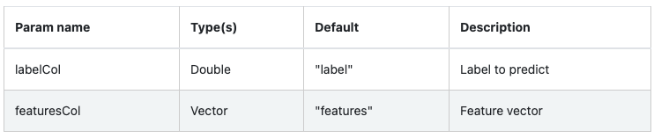
Decision Trees - Input Columns

Slide 8
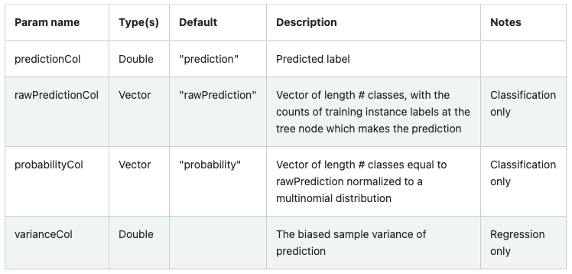
Decision Trees - Output Columns

Slide 9
Decision Trees - Classification
from pyspark.ml import Pipeline
from pyspark.ml.classification import DecisionTreeClassifier
from pyspark.ml.feature import StringIndexer, VectorIndexer
from pyspark.ml.evaluation import MulticlassClassificationEvaluator
data = spark.read.format("libsvm").load("data/mllib/sample_libsvm_data.txt")
labelIndexer = StringIndexer(inputCol="label", outputCol="indexedLabel").fit(data)
# Automatically identify categorical features, and index them.
# We specify maxCategories so features with > 4 distinct values are treated as continuous.
featureIndexer = \
VectorIndexer(inputCol="features", outputCol="indexedFeatures",
maxCategories=4).fit(data)
(trainingData, testData) = data.randomSplit([0.7, 0.3])
dt = DecisionTreeClassifier(labelCol="indexedLabel",
featuresCol="indexedFeatures")
pipeline = Pipeline(stages=[labelIndexer, featureIndexer, dt])
model = pipeline.fit(trainingData)

Slide 10
Decision Trees - Regression
from pyspark.ml.regression import DecisionTreeRegressor
dt = DecisionTreeRegressor(labelCol="price")
# Filter for just numeric columns (and exclude price, our label)
numericCols = [field for (field, dataType) in trainDF.dtypes
if ((dataType == "double") & (field != "price"))]
# Combine output of StringIndexer defined above and numeric columns
assemblerInputs = indexOutputCols + numericCols
vecAssembler = VectorAssembler(inputCols=assemblerInputs,
outputCol="features")
# Combine stages into pipeline
stages = [stringIndexer, vecAssembler, dt]
pipeline = Pipeline(stages=stages)
pipelineModel = pipeline.fit(trainDF)

Slide 11
Decision Trees - maxBins Parameter
maxBins Parameter
Determines the number of bins into which the continuous features are discretized (split)
Discretization step is crucial for performing distributed training.
There is no maxBins parameter in scikit-learn because all of the data and the model reside on a single machine.
In Spark, workers have all the columns of the data, but only a subset of rows. It is important to use the same split values (features and values to split on) from the common discretization set up at training time.
Every worker has to compute summary statistics for every feature possible split point which are then aggregated across the workers.
maxBins need to be large enough to handle the discretization of the categorical columns (default 32).

Slide 12
Decision Trees - Numeric vs Categorical Features
It is possible to split on the same feature more than once, but at different split values
Difference between splits on numeric features versus categorical features
For numeric features it checks if the value is less than or equal to the threshold
For categorical features it checks if the value is in the set or not

Slide 13
Decision Trees
# Printing if-then-else rules
dtModel = piplineModel.stages[-1]
print(dtModel.toDebugString)
# Extracting feature importance scores from the model
import pandas as pd
featureImp = pd.DataFrame(
list(zip(vecAssembler.getInputCols(),
dtModel.featureImportances)),
﻿columns=["feature", "importance"])
featureImp.sort_values(by="importance", ascending=False)

Slide 14
Tree Ensembles
DataFrame API supports two major tree ensemble algorithms
Random Forests
Gradient-Boosted Trees
Both use spark.ml decision trees as their base models
Difference between ML and MLlib implementations
Support for DataFrames and ML Pipelines
Separation of classification vs. regression
Use of DataFrame metadata to distinguish continuous and categorical features
More functionality for random forests: estimates of feature importance, as well as the predicted probability of each class (a.k.a. class conditional probabilities) for classification.
References:
https://spark.apache.org/docs/3.1.1/ml-classification-regression.html#tree-ensembles
https://spark.apache.org/docs/3.1.1/mllib-ensembles.html

Slide 15
Tree Ensembles - GBT vs Random Forests
GBTs train one tree at a time
Take longer to train than random forests. Random Forests can train multiple trees in parallel.
On the other hand, it is often reasonable to use smaller (shallower) trees with GBTs than with Random Forests, and training smaller trees takes less time.
Random Forests can be less prone to overfitting. Training more trees in a Random Forest reduces the likelihood of overfitting, but training more trees with GBTs increases the likelihood of overfitting.
Random Forests can be easier to tune since performance improves monotonically with the number of trees (whereas performance can start to decrease for GBTs if the number of trees grows too large).

Slide 16
Random Forests
Random forests are an ensemble of decision trees.
In statistics and machine learning, ensemble methods use multiple learning algorithms to obtain better predictive performance than could be obtained from any of the constituent learning algorithms alone. (https://en.wikipedia.org/wiki/Ensemble_learning)
Building many models and combining/averaging their prediction produce more robust results than the ones produced by an individual model.

Slide 17
Random Forests - Bagging
Bootstrapping samples by rows
Bootstrapping: a technique for simulating new data by sampling with replacement from the original data.
Each decision tree is trained on a different bootstrap sample of the data set
This produces slightly different decision trees.
The predictions are aggregated => bootstrap aggregating, or bagging
Each tree samples the same number of data points controlled through the subsamplingRate parameter

Slide 18
Random Forests - Bagging
Decision trees are sensitive to the specific data sets on which they are trained.
Bagging is the application of the Bootstrap procedure for high-variance algorithms.
Bagging of Classification And Regression Trees (CART)
Create many random sub-samples of the dataset with replacement
Train a CART model using each sample
For a new dataset, calculate the average prediction from each model

Slide 19
Random Forests - Random Feature Selection
Random feature selection by columns
Issue with the bagging: The trees are highly correlated, and learn similar patterns in the data.
Solution: Each time a split is made, a random subset of the columns are selected.
Due to the randomness, each tree will need to be shallow.
Each tree learns something different from the data set
Combining the collection of “weak” learners into an ensemble makes the forest much more robust than a single decision tree.

Slide 20
Random Forests - Random Feature Selection
A problem with decision trees (CART) is that they are greedy – it uses a greedy algorithm to minimize the error when choosing a variable to split on.
Random forest makes a simple tweak …
It changes the algorithms for the way sub-trees are learned to reduce the correlation between prediction results.
In CART, when selecting a split point, the algorithm looks through all variables and values to select the most optimal split-point.
In Random forest, the learning algorithm is limited to a random sample of features
Each tree learns something new about the data set. Collection of “weak” learners into an ensemble makes the forest much more robust.

Slide 21
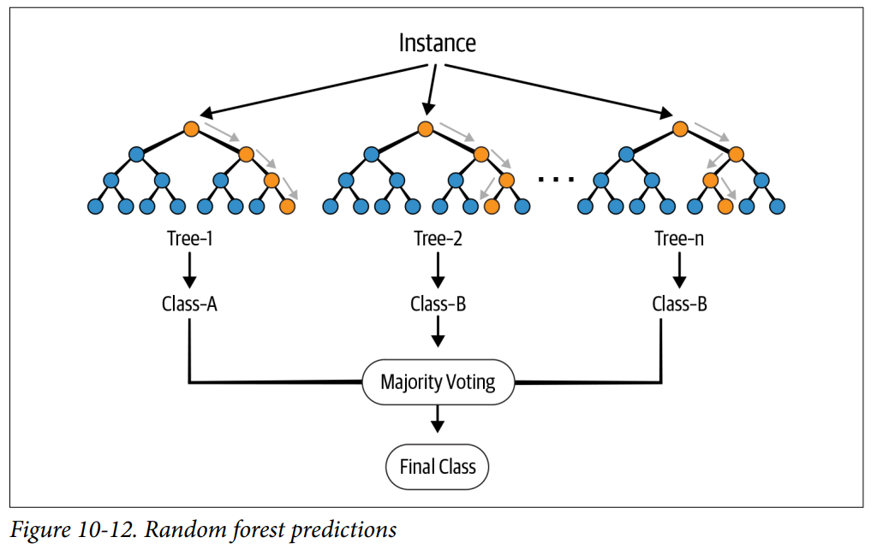
Random Forests

Slide 22
Random Forests
from pyspark.ml.regression import RandomForestRegressor
rf = RandomForestRegressor(labelCol="price", maxBins=40, seed=42)

Slide 23
K-Fold Cross-Validation
Hyperparameters for Random Forest
The number of trees to train
Maximum depth of the trees
Which data set to use to determine the optimal hyperparameter values?
Using training data set - Overfit
Using testing data set – No longer “unseen” data, will not be able to verify how well the model generalizes.
We can use another data set – Validation data set
60/20/20 split for training, testing and validation
Validation data set is used to evaluate the performance to select the best hyperparameter configuration.
Issue? 25% of the training data is lost

Slide 24
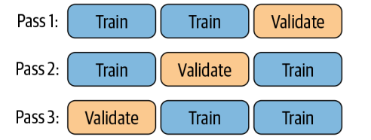
K-Fold Cross-Validation
Using k-fold cross-validation, we are able to determine the best hyperparameter configuration without losing the training data.
Split the data into training and testing
Use the training data for both training and validation
Split the training data into k subsets (folds)
Given a hyperparameter configuration, train the model on k-1 folds and evaluation on the remaining fold.
Repeat the process k times.
Use the average of the performance of the validation as the proxy of how well the model performs with unseen data
Repeat the process for all different parameter configuration to identify the optimal one.

Slide 25
Hyperparameter Search
Define the estimator to evaluate.
Specify which hyperparameter to vary along with the values using the ParamGridBuilder.
Define an evaluation to specify which metric to use to compare the various models.
Use the CrossValidator to perform cross-validation, evaluating each of the various models.

Slide 26
Hyperparameter Search
pipeline = Pipeline(stages = [stringIndexer, vecAssembler, rf])
from pyspark.ml.tuning import ParamGridBuilder
paramGrid = (ParamGridBuilder()
.addGrid(rf.maxDepth, [2, 4, 6])
.addGrid(rf.numTrees, [10, 100])
.build())
evaluator = RegressionEvaluator(labelCol="price",
predictionCol="prediction",
metricName="rmse")
from pyspark.ml.tuning import CrossValidator
cv = CrossValidator(estimator=pipeline,
evaluator=evaluator,
estimatorParamMaps=paramGrid,
numFolds=3,
seed=42)
cvModel = cv.fit(trainDF)
list(zip(cvModel.getEstimatorParamMaps(), cvModel.avgMetrics))

Slide 27
Optimizing Pipelines
For CrossValidator, parallelism parameter determines the number of models to train in parallel.
The value of parallelism should be chosen to maximize parallelism without exceeding cluster resources
Larger values do not always lead to improved performance
A value of up to 10 should be sufficient for most clusters.
cvModel = cv.setParallelism(4).fit(trainDF)

Slide 28
Optimizing Pipelines
Putting the cross-validator inside the pipeline instead of putting the pipeline inside the cross-validator.
This eliminates the need to remove steps that don’t change. E.g. There is no need to reevaluate StringIndexer.
cv = CrossValidator(estimator=rf,
evaluator=evaluator,
estimatorParamMaps=paramGrid,
numFolds=3,
parallelism=4,
seed=42)
pipeline = Pipeline(stages=[stringIndexer, vecAssembler, cv])
pipelineModel = pipeline.fit(trainDF)

Slide 29
Managing Models
End-to-end reproducibility of machine learning solutions - Ability to reproduce …
The code that generated a model
The environment used in training
The data used in training
The model

Slide 30
Managing Models
Library versioning
Which libraries and which versions of them are used?
Using the latest version of library can cause the code to break
Data evolution
Drafts in data (shape of the data and tendency of the data) makes reproducing of the results difficult
Order of execution
Running the cells in order!
Checking in the code
Parallel operations
GPUs running operations in parallel can exacerbate the possibility of producing different results, leading to nondeterministic outputs. This is because the order of the execution is not always guaranteed.

Slide 31
MLflow
MLflow: An open source MLOps platform, which helps developers to manage, reproduce and share models. It has four components:
Tracking – provides APIs to record parameters, metrics, code versions, models, and artifacts (plots, text, etc)
Projects – A standardized format to package data science projects and their dependencies to run on other platforms. Helps to manage the model training process
Models – A standardized format to package models to deploy to diverse execution environments. It provides a consistent API for loading and applying models, regardless of the algorithms or library used to build the model
Registry – A repository to keep track of model lineage, model versions, stage transitions, and annotations

Slide 32
MLflow - Tracking
Logging API agnostic to the libraries and environments that actually do the training.
Organized around the concept of runs (execution of data science code).
Runs are aggregated into experiments
Many runs can be part of a given experiment.
Things that can be logged:
Parameters: key/value pairs including hyperparameters (e.g. num_trees, max_depth)
Metrics: Numeric values (e.g. RMSE or accuracy values)
Artifacts: Files, data, and models (e.g. matplotlib images, Parquet files)
Metadata: Information about the run (e.g. source code and version of the code)
Models: The model that has been trained.

Slide 33
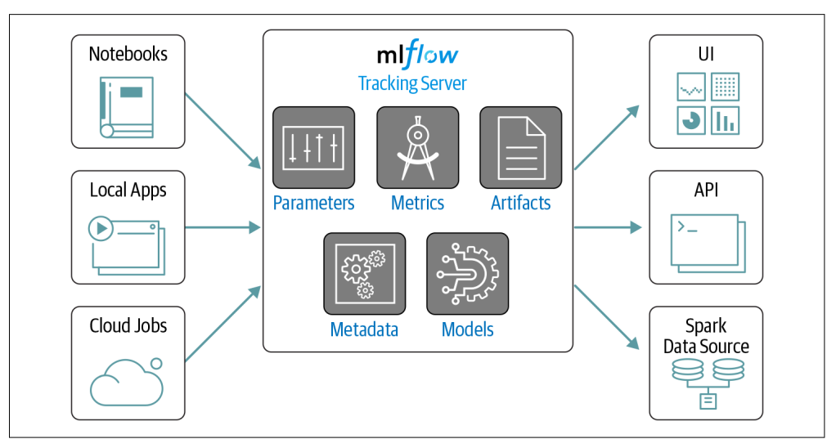
MLflow - Tracking

Slide 34
Links and Labs
Labs
Binary Classification
Automated MLflow tracking in Mllib
Distributed Hyperopt + Automated MLflow Tracking
Links
https://medium.com/data-design/visiting-categorical-features-and-encoding-in-decision-trees-53400fa65931

Slide 35

Questions

